Slide 1
Permutation-symmetric three-particle hyper-spherical harmonics
I. Salom and V. Dmitrašinović

Slide 2
Solving two particle problems
Using center-of-mass reference system where a single 3-dim vector determines position
Split wave function into radial and angular parts
Using basis of spherical harmonics for the angular wave function (essential)!

Slide 3
Goal in 3-particle case
Use c.m. system and split the problem into radial and angular parts
Interaction is not radial-only, but in all realistic interaction potentials “radial” component is dominant – starting point for perturbation approach
Solve angular part by decomposition to (hyper)spherical harmonics
Account for some special dynamical symmetries (e.g. Y-string three-quark potential)
Harmonics provide manifest permutation and rotation properties
Applications: three quark systems, molecular physics, atomic physics (helium atom), positronium ion…

Slide 4
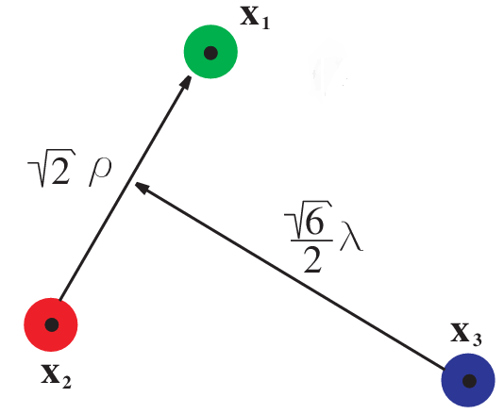
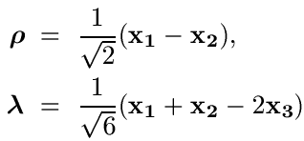


Center-of-mass system
Jacobi coordinates:
Non-relativistic energy – SO(6) invariant:
In the case of different masses coordinates are more complicated

Slide 5



Hyper-spherical coordinates
Triangle shape-space parameters:
Plus angles that fix the position/orientation of the triangle plane (some Φ₁, Φ₂, Φ₃ )
Smith-Iwai
Choice of angles

Slide 6
D-dim hyper-spherical harmonics
Intuitively: natural basis for functions on D-dim sphere
Functions on SO(D)/SO(D-1) – transform as traceless symmetric tensor representations (only a subset of all tensorial UIRs)
UIR labeled by single integer K, highest weight (K, 0, 0,…) <=> K boxes in a single row <=> K(K+D-2) quadratic Casimir eigenvalue
Homogenous harmonic polynomials (obeying Laplace eq. = traceless) of order K restricted to unit sphere
Harmonics of order K are further labeled by appropriate quantum numbers, usually related to SO(D) subgroups

Slide 7
I - Case of planar motion
4 c.m. degrees of freedom - Jacobi coordinates:
or spherically R, α, φ and Φ
Hyper-angular momenta – so(4) algebra:
conjugated to overall angular momentum

Slide 8


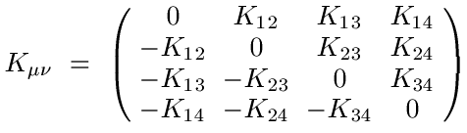

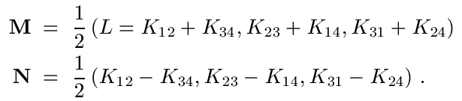


Decomposition:
= G
Y-string potential = the shortest sum of string lengths ← function of triangle area

Slide 9



Hyper-spherical harmonics
Labeled by K, L and G:
Functions coincide with SO(3) Wigner D-functions:
Interactions preserve value of L (rotational invariance) and some even preserve G (area dependant like the Y-string three-quark potential)

Slide 10


Calculations now become much simpler…
We decompose potential energy into hyper-spherical harmonics and split the problem into radial and angular parts:

Slide 11
II - Case of 3D motion
6 c.m. degrees of freedom - Jacobi coordinates:
or spherically R, α, φ and some Φ₁, Φ₂, Φ₃
Hyper-angular momenta – so(6) algebra:
Tricky!

Slide 12
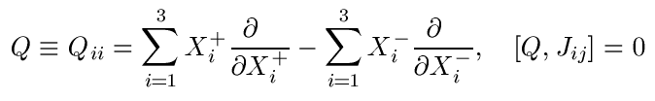

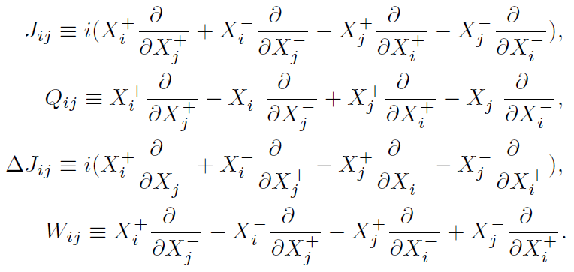
Decomposition
Complex Jacobi coord.:
SO(3)
rotations
SO(6)
U(3)

Slide 13




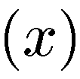

Quantum numbers
Labels of SO(6) hyper-spherical harmonics
U(1)
SO(6)
multiplicity
SU(3)
SO(3)  SO(2)

Slide 14





“Core polynomials”
Building blocks – two SO(3) vectors and
Start from polynomials sharp in Q:
Define “core polynomials” sharp in J, m and Q:
Core polynomial certainly contains component with
but also lower K components

Slide 15




“Harmonizing” polynomials
Let be shortened notation for all core polynomials with K values less than some given
Harmonic polynomials are obtained as ortho-complement w.r.t. polynomials with lesser K, i.e.:
where are deduced from requirement:
Scalar product of core polynomials

Slide 16
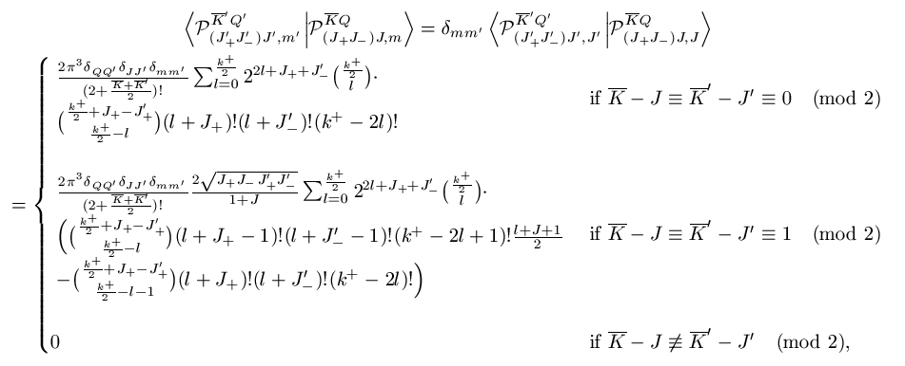


Scalar product of polynomials on hyper-sphere
Defined as
it can be shown that:
that for core polynomials eventually leads to a closed-form expression…
Integral of any number of polynomials can be evaluated (e.g. matrix elements)

Slide 17







Multiplicity
E.g. this can be
or often used operator
Exist nonorthogonal and
Degenerated subspace:
We remove multiplicity by using physically appropriate operator - obtain orthonormalized spherical harmonic polynomials as:
where and U is a matrix such that:

Slide 18




Particle permutations
Transformations are easily inferred since:
…

Slide 19

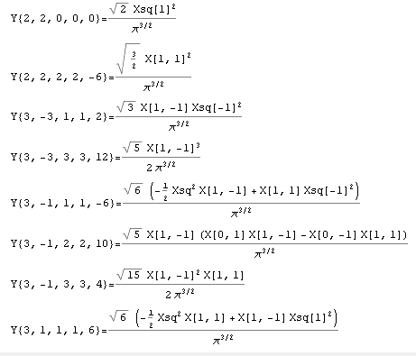
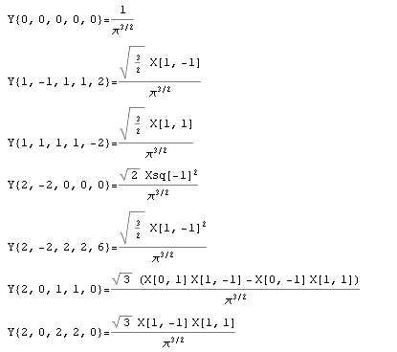
Finally and most importantly…
Explicitly calculate harmonics in Wolfram Mathematica…
…

Slide 20
Thank you

Slide 21



Hyper-spherical coordinates
Triangle shape-space parameters:
Plus angles that fix the position/orientation of the triangle plane (some Φ₁, Φ₂, Φ₃ )
Smith-Iwai
Choice of angles

