Slide 1
Gravitational lensing as a powerful tool in observational cosmology
Predrag Jovanović
Astronomical Observatory
Belgrade, Serbia

Slide 2
Outline
Gravitational lenses:
  basic principles and types:
    strong (macro and micro)-lensing
    weak lensing
  theory and cosmological applications
Our investigations:
  gravitational lensing statistics
  optical depth for cosmological distribution of gravitational microlenses
  investigation of physics and space-time geometry in vicinity of supermassive black holes (SMBHs) using gravitational microlensing
Conclusions

Slide 3
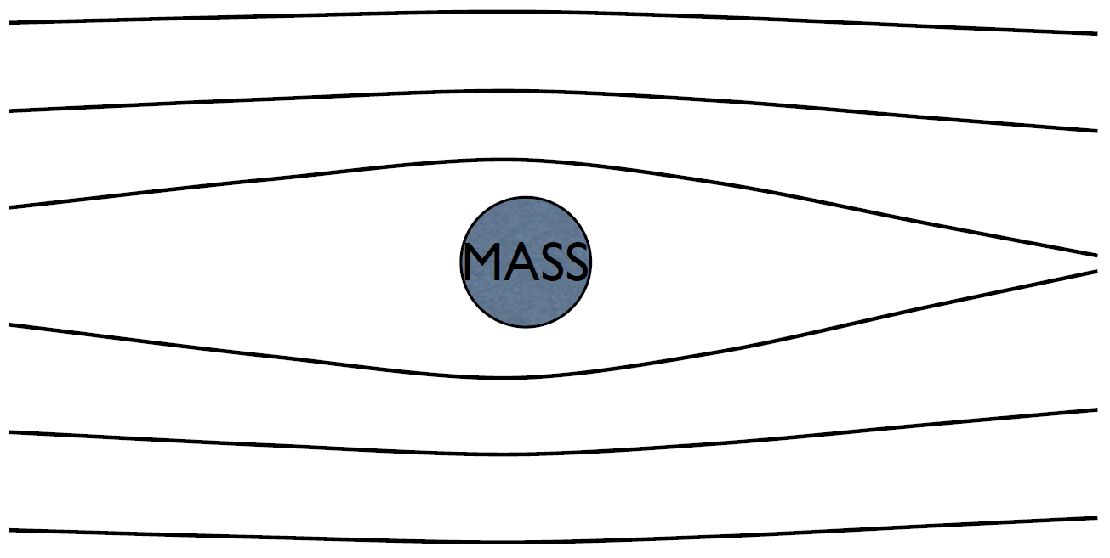
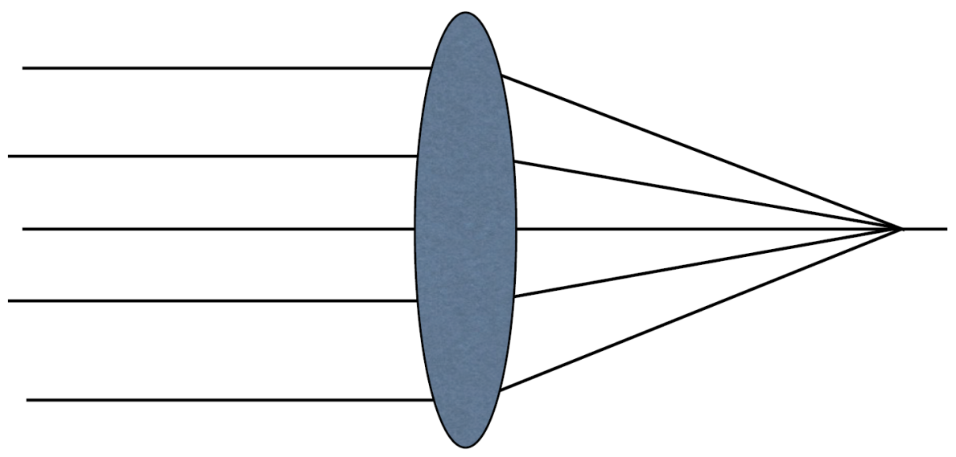
Light bending in the gravitational field
light “falls” under the gravity
Newton: gravitational bending of the paths of "corpuscles" (particles from which light is composed)
General Relativity: light follows geodesics
coverging lens in optics:
  deflection is larger further from the axis
  focusing to a point
gravitational lens:
  deflection is larger closer to the axis
  focusing to a line
Gravitational (top) vs optical lens (bottom)

Slide 4
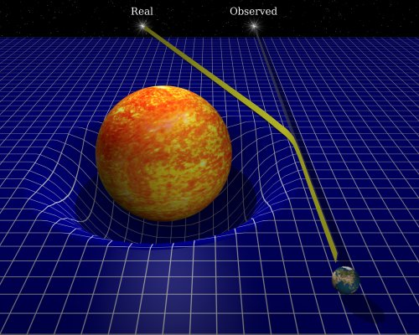
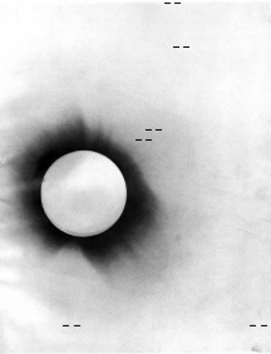
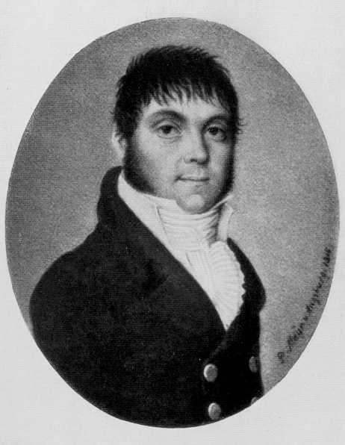
Light deflection angle
Johann Georg von Soldner (1804) - trajectory of particle with speed c:
Albert Einstein (1915) -General Relativity:
Total solar eclipse in 1919:
no light bending: α = 0"
Newton's mechanics: α = 0".87
GR: α = 1".75
Confirmation of Einstein’s predictions:
α₁ = 1".98 ± 0".12 α₂ = 1".61 ± 0".30

Slide 5
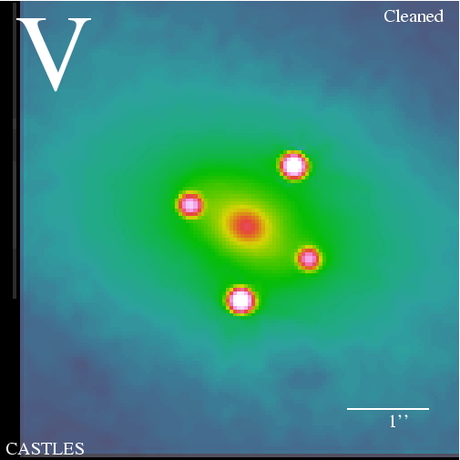
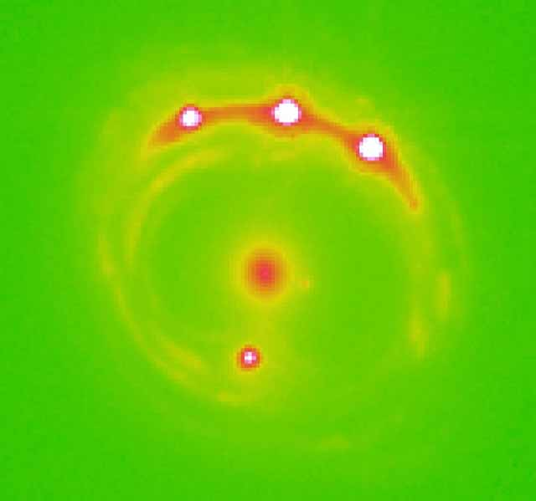
Gravitational lensing types and applications
Strong lensing (natural telescopes):
  by galaxies (macrolensing) - multiple images of the background sources: determination of cosmological parameters (H₀ from time delays, Ω_{M}, Ω_{Λ}, Ω_{k} from lensing statistics)
  by clusters of galaxies - giant arcs as images of distant background galaxies: finding the most distant galaxies in the Universe
  by stars (microlensing) - amplification (magnification) of the background sources: detection of extrasolar planets, studying the innermost regions of active galaxies around their central supermassive black holes, constraining cosmological parameters
Weak lensing:
  by foreground matter - shape distortions of the background sources: the only direct mean to detect the dark matter, studying the distribution of visible and dark matter in the Universe
Q2237+030 (Einstein cross) at z=1.695 and lensing galaxy ZW2237+030 at z=0.0394
RXJ1131-1231

Slide 6
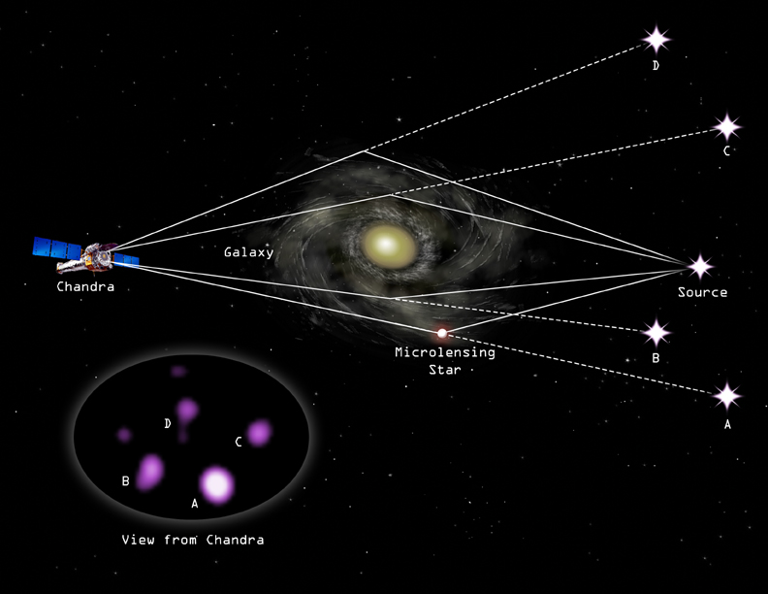
Strong lensing: macro and microlensing

Slide 7
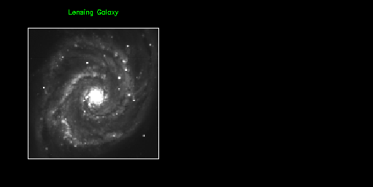
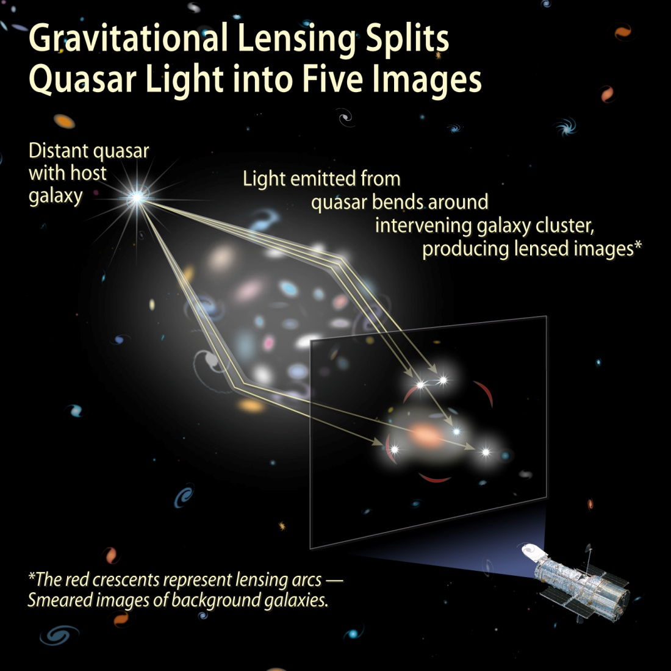
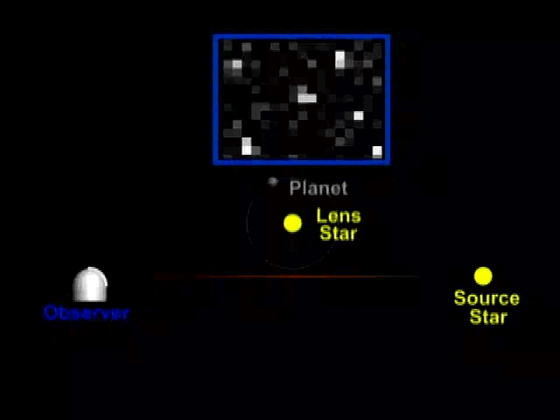

Slide 8
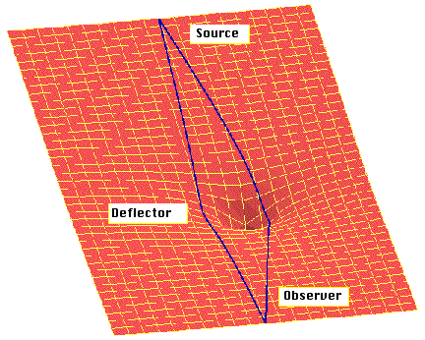
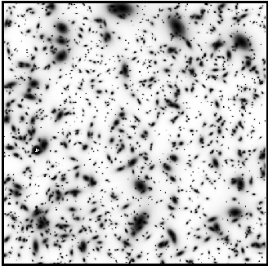
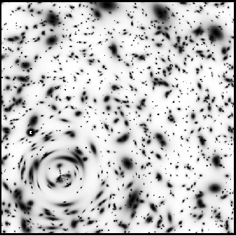
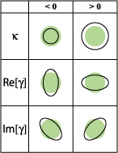
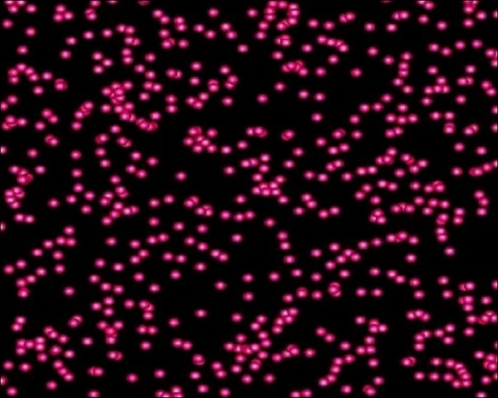
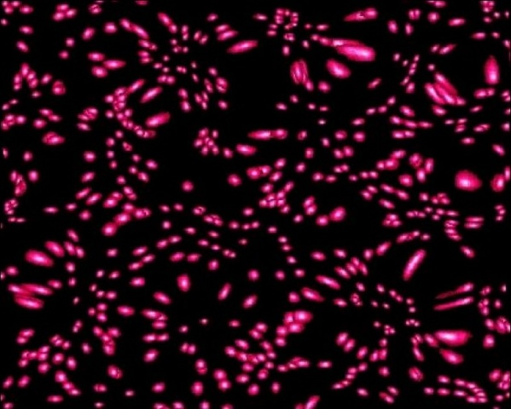
Weak lensing
Background galaxies in absence of lensing
Background galaxies lensed by invisible foreground circular cluster
without weak lensing
with weak lensing

Slide 9
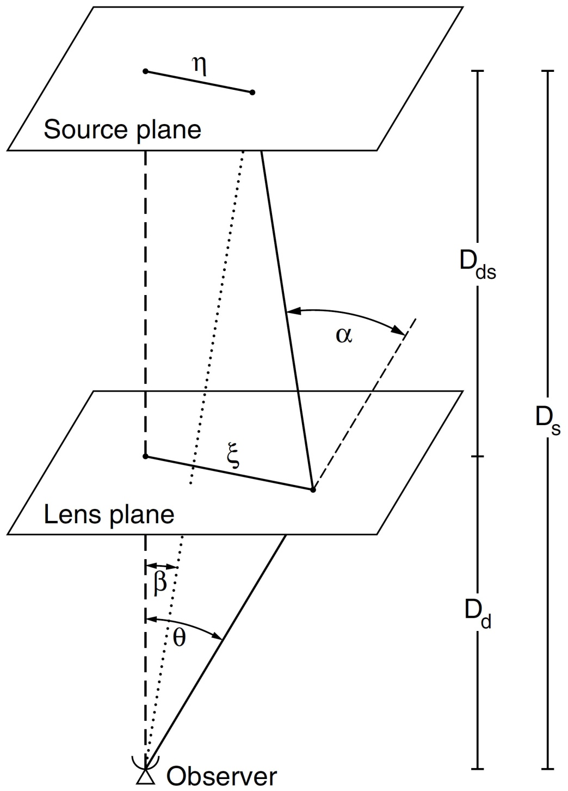
Gravitational lensing theory
In the weak gravitational field (i.e. for a small deflection angle), a ray can be approximated as a straight line near the deflecting mass
A mass distribution for which this condition is satisfied is called a geometrically thin lens
Lens equation:
Solution for Einstein radius:
(linear)
(angular)

Slide 10
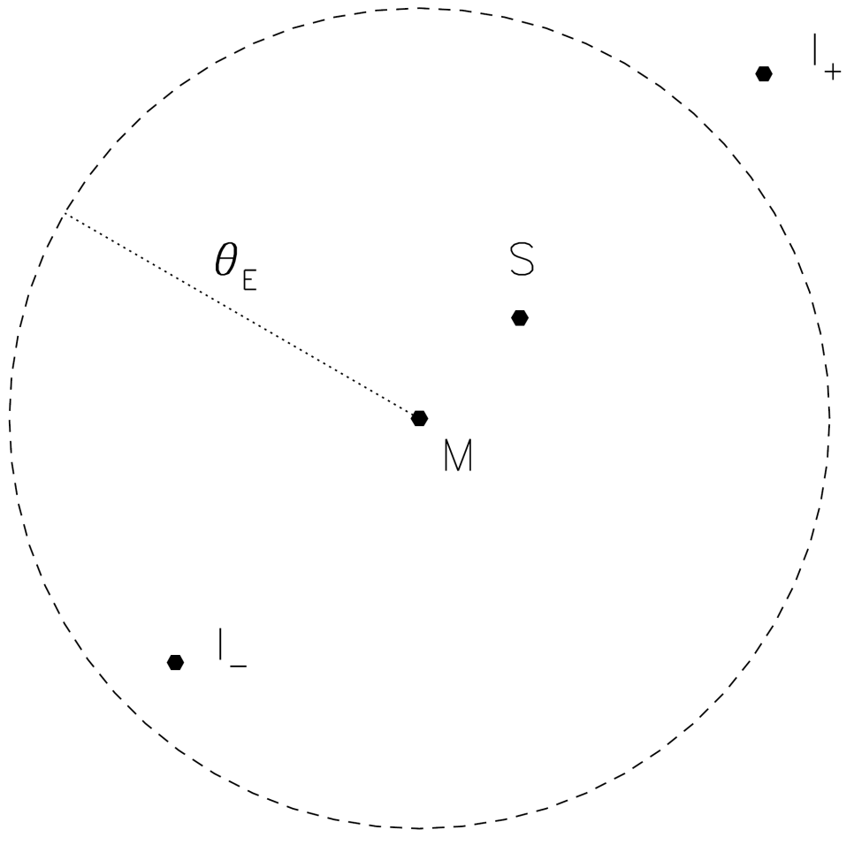
Point-like lens
lens equation in the case of a single point lens:
image positions:
gravitational lensing conserves surface brightness
magnification of an image: ratio between
the solid angles of the image and the source:
magnification of the images in the case of a
single point lens:
u = β / θ_{E}

Slide 11
Deflection potential
deflection angle of an ensemble of mass:
z - line-of-sight coordinate,
- infinitesimal mass
scaled deflection angle = gradient of the deflection potential ψ:
convergence - dimensionless surface mass density:
Σ_{cr} - characteristic value for the surface mass density which separates "weak" from "strong" lensing:
a mass distribution which has κ ≥ 1, i.e. Σ ≥ Σ_{cr} produces multiple images
relationship between the deflection potential ψ
and the Newtonian potential Φ:

Slide 12
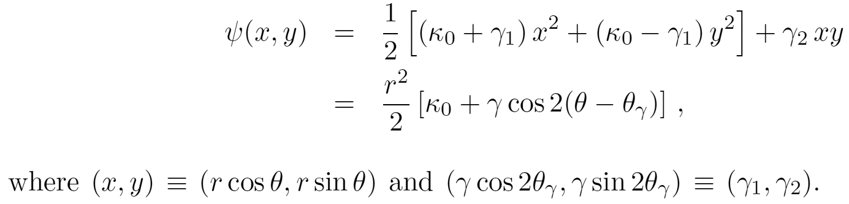
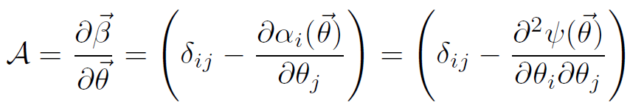
Shear approximation
expansion of the deflection potential in a Taylor series:
ψ₀ = 0 since constant terms in the potential have no effect on lensing
ψ_{x} and ψ_{y} correspond to constant terms in the reduced deflection angle
Definitions:
κ₀ - convergence: gives rise to isotropic magnification
γ - shear: describes the quadrupole term of the perturbing potential
The potential is then:
Distortion matrix - Jacobian of the lens equation:

Slide 13
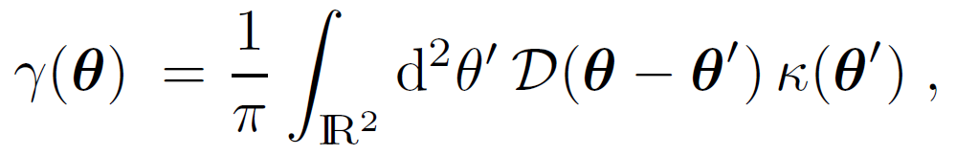
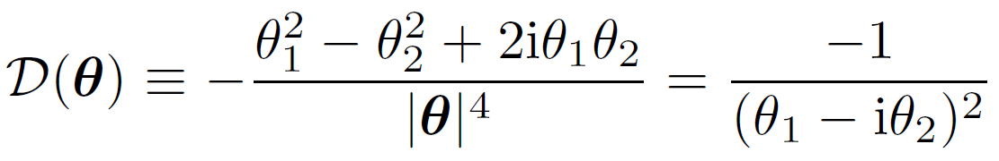

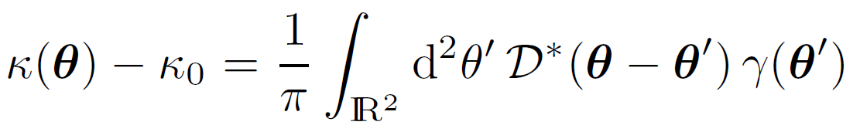
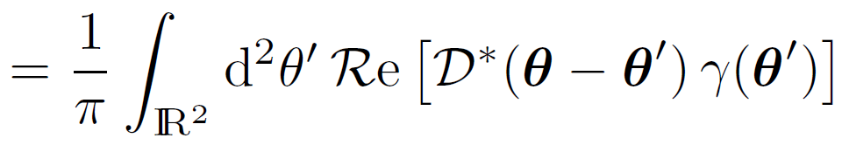
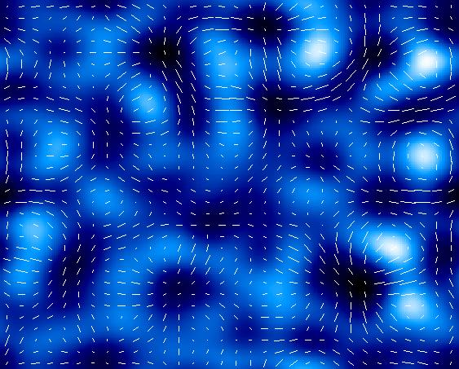
Mass reconstructions from weak lensing
The Kaiser–Squires Inversion:
relation between shear γ and convergence κ in form of a convolution with the kernel D which describes the shear generated by a point mass:
in Fourier space this convolution
becomes a multiplication:
which can be inverted to yield:
Fourier back-transformation then yields the surface mass density:
projected mass and shear

Slide 14
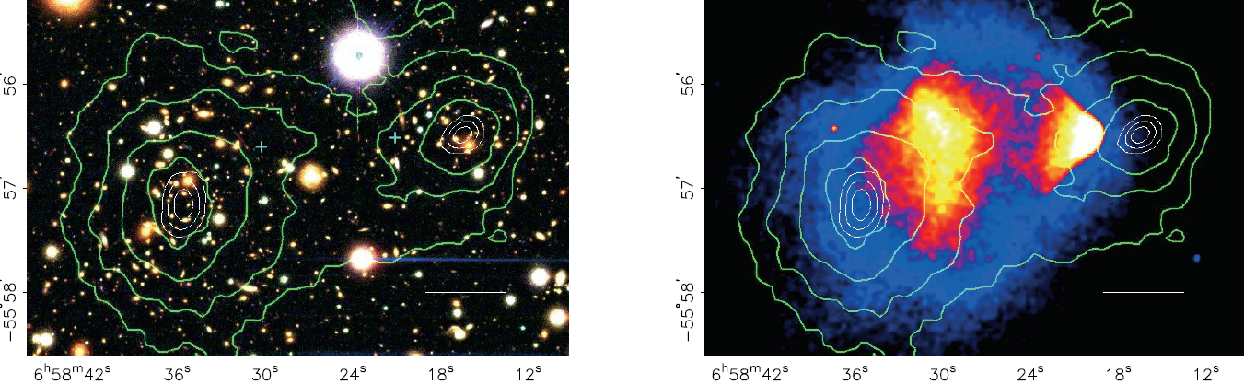
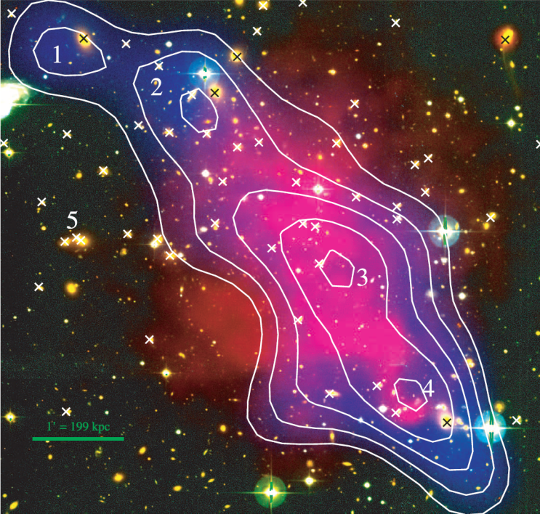
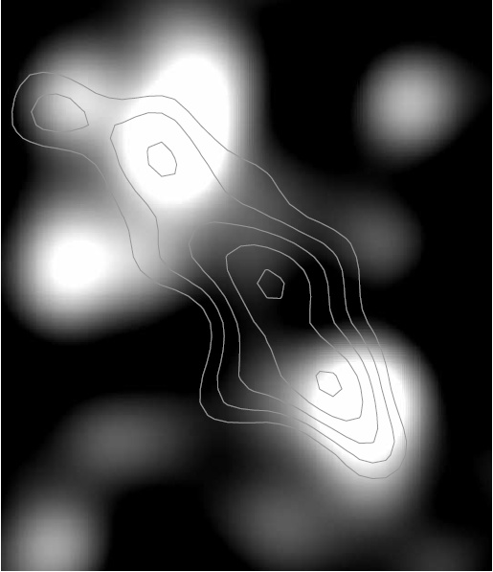
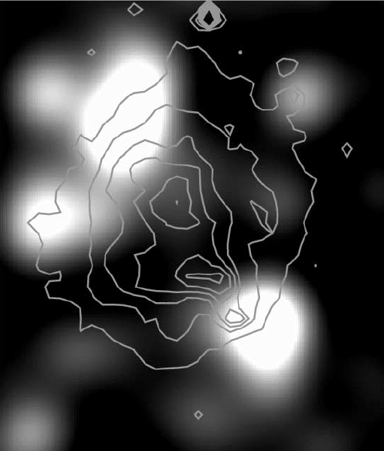
Detection of dark matter
1E 0657-558 – “Bullet Cluster” (Clowe et al. 2004, ApJ, 604, 596)
A dark core in Abell 520 (Mahdavi et al. 2007, ApJ, 668, 806)

Slide 15


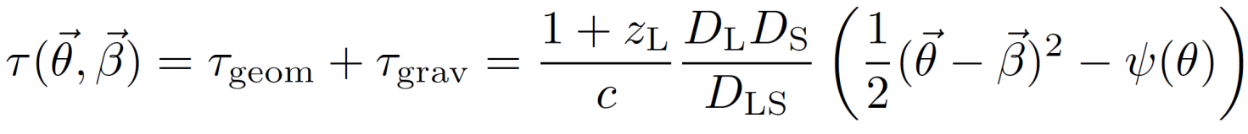
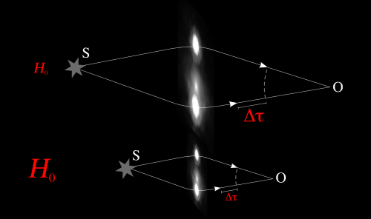
Fermat potential and time delay
Fermat potential is a function of the form:
physical meaning: it is, up to an affine transformation, the light travel time along a ray starting at position , traversing the lens plane at position and arriving at the observer
Fermat principle: the physical light rays are those for which the light travel time is stationary
physical time delay function for gravitationally lensed images:
τ_{geom} - extra path length between observer and source
τ_{grav} - retardation due to gravitational potential (Shapiro delay)
τ depends on the value of the Hubble constant
the lens equation:
images appear at locations that correspond to extrema in τ

Slide 16
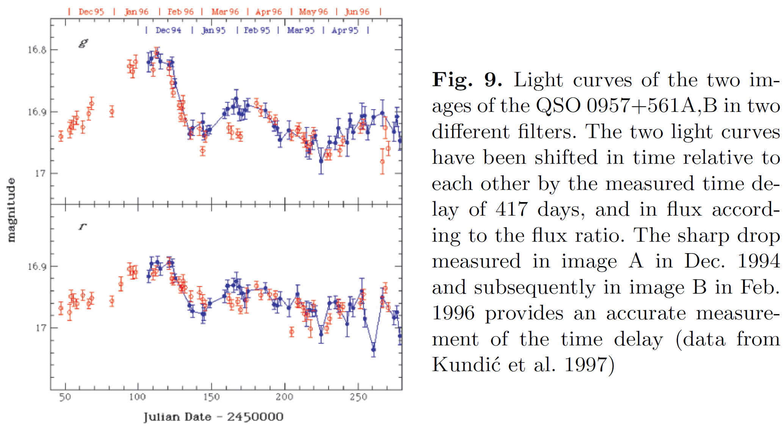
Measuring time delays by cross-correlation between the light curves of images

Slide 17
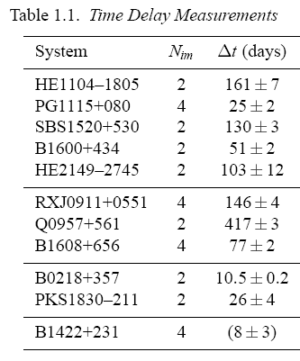
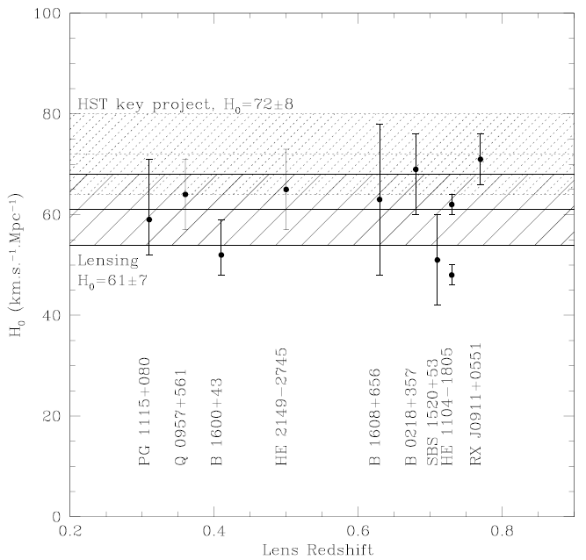
Determining H₀ from lensing time delays
Schechter, 2005, IAU Symposium 225, 281

Slide 18
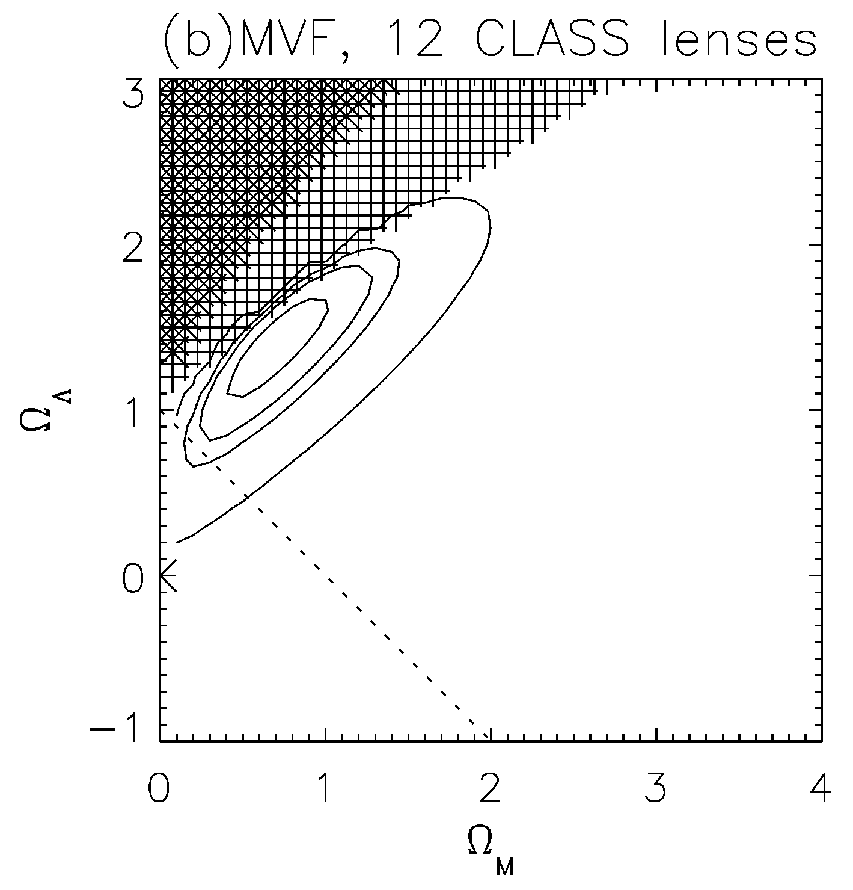
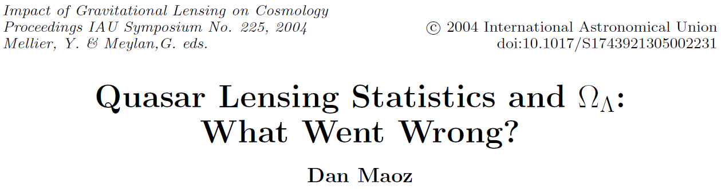
Optical depth and statistics of strong lenses
optical depth (chance of seeing a lensing effect): probability that at any instant of time a source is covered by the Einstein ring of a deflector
Optical depth for strong lensing (Mitchell et al. 2005, ApJ, 622, 81):
φ(ϭ) - velocity function, A - cross section for multiple imaging, B - magnification bias,
dV - differential comoving volume element
first results not in agreement with other cosmological tests
Mitchell et al. 2005, ApJ, 622, 81

Slide 19
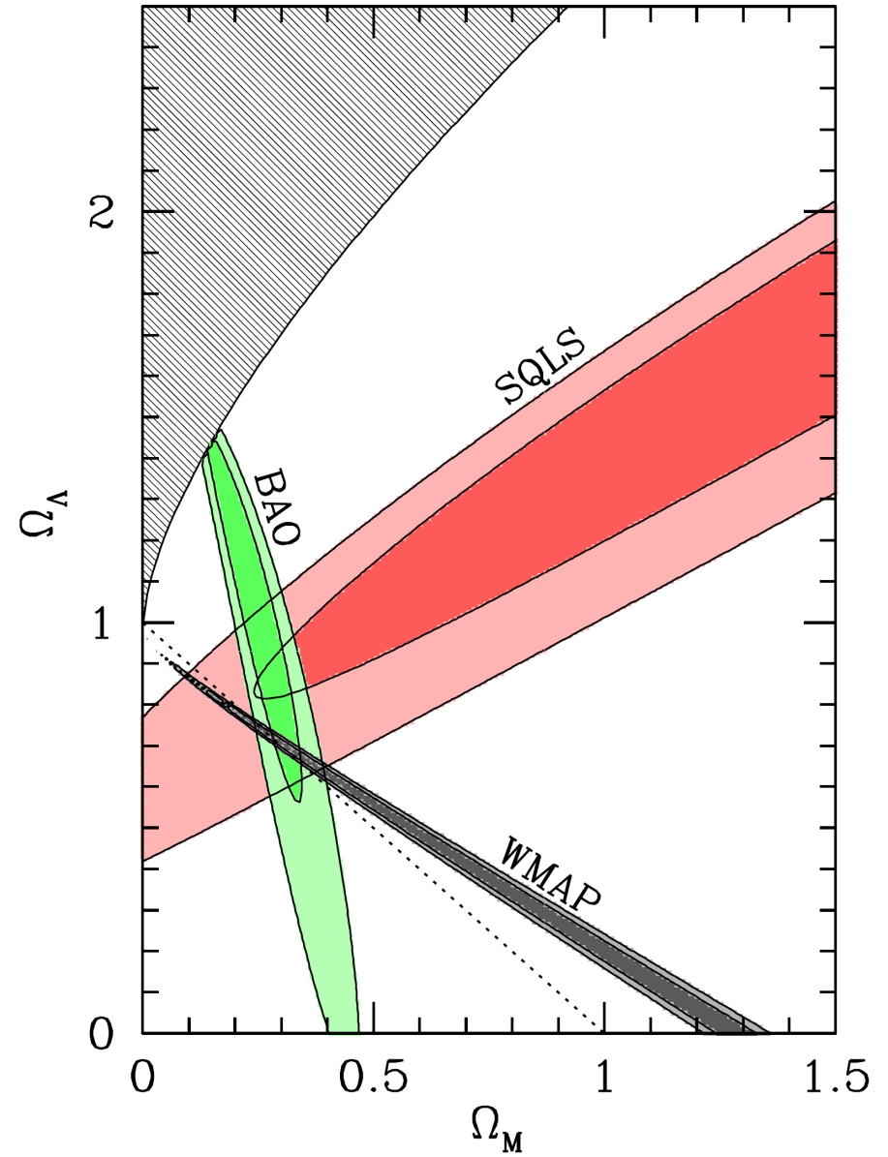
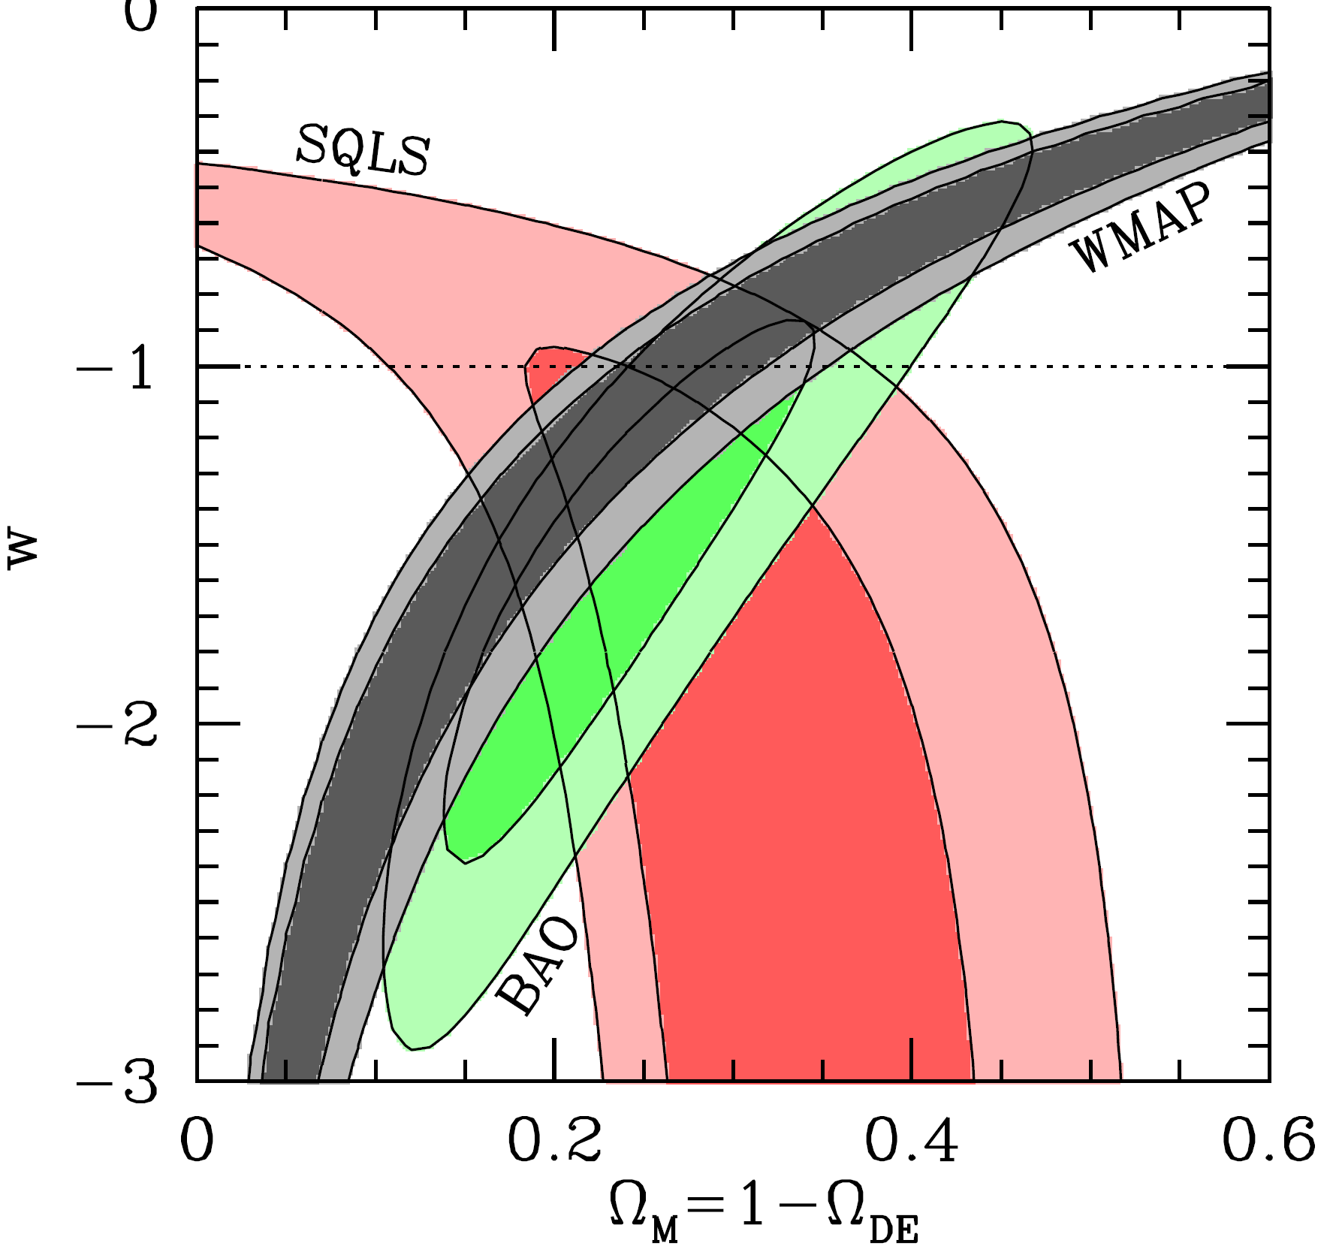
Constraints on cosmological parameters
New results from 2012 in agreement with other cosmological tests
(Cao et al. 2012, ApJ, 755, 31; Oguri et al. 2012, AJ, 143 120)
1σ and 2σ confidence regions for Ω_{M} and Ω_{Λ} for the non-flat models with a cosmological constant
1σ and 2σ confidence regions for Ω_{M} and w for the flat dark energy models

Slide 20
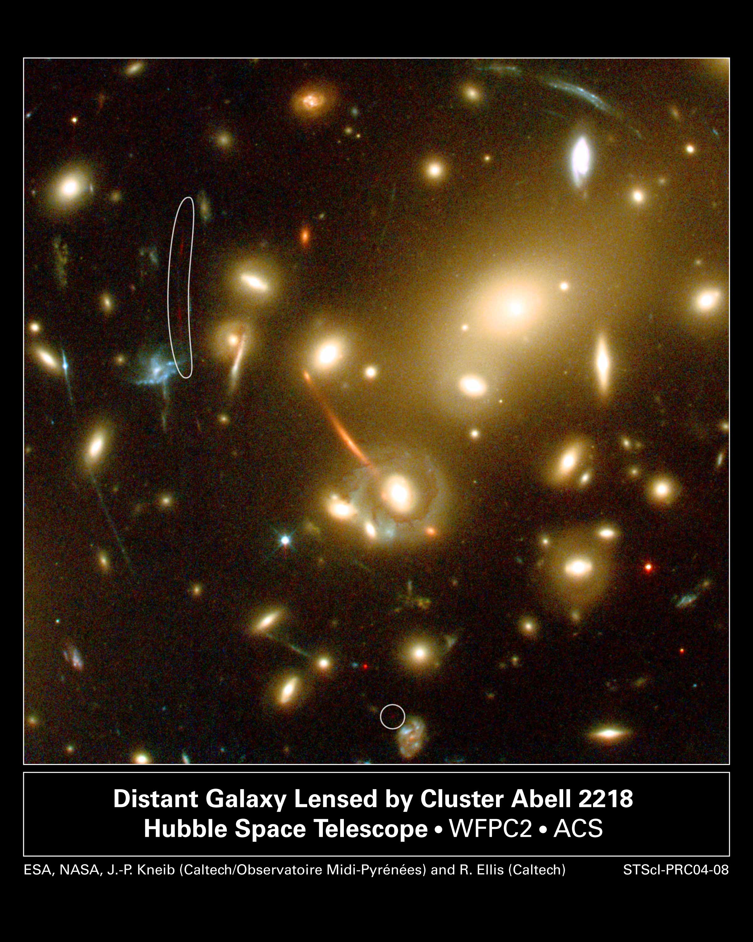
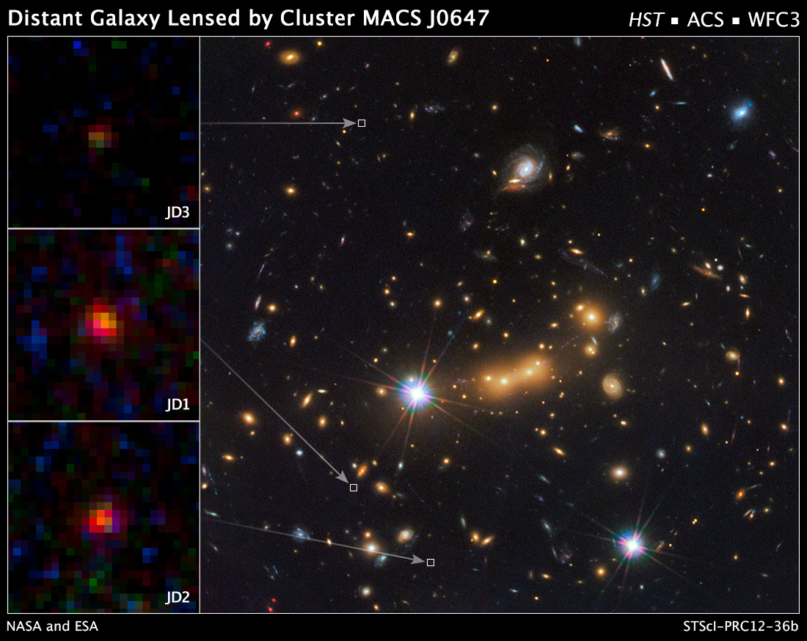
Finding the most distant galaxies
MACS0647-JD, the most distant galaxy discovered in 2012: the distance to the cluster is 5.6 billion ly (z = 0.591) and to the lensed galaxy is 13.3 billion ly (z = 10.7)
Red arc and point: the most distant galaxy known until 2004, located at z~7 (≈13×10⁹ ly)

Slide 21
Our results
Gravitational lensing statistics
Optical depth for cosmological distribution of gravitational microlenses
Investigation of physics and space-time geometry in vicinity of supermassive blackholes (SMBHs) using gravitational microlensing
Microlensing timescales

Slide 22
Macrolensing optical depth
Sample of 85221 (N_{QSO}) quasars from which 69 (N_{GL}) are with multiple images (macrolenses), taken form catalogue: Veron-Cetty & Veron, 2006, A&A, 455, 773
Effective optical depth:
Jovanović & Popović , 2009, SSSCP Conf. Proc.

Slide 23
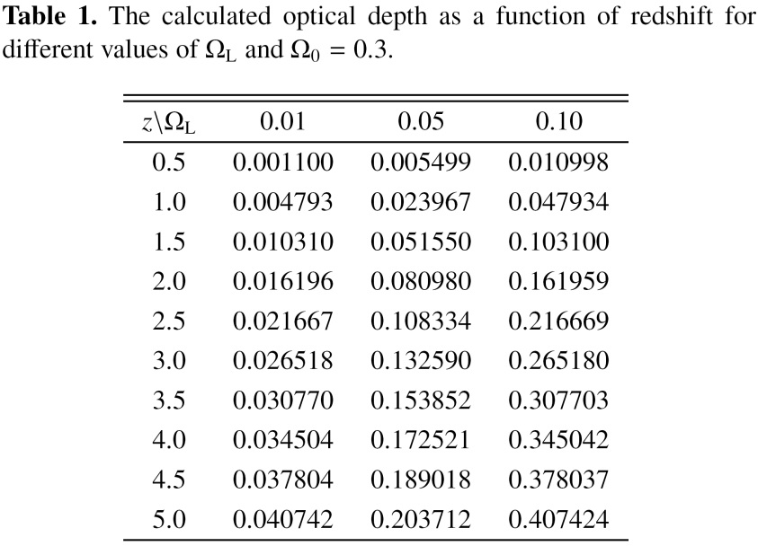
Optical depth for cosmological distribution of gravitational microlenses
Zakharov, Popović & Jovanović, 2004, A&A, 881:
Ω_{L} – matter fraction in compact lenses; λ(z) – affine distance (in cH₀^{–1})
Ω_{L} = 0.01: 25% of baryonic matter forms microlenses
Ω_{L} = 0.05: almost all baryonic matter forms microlenses
Ω_{L} = 0.1: about 30% of dark matter forms microlenses

Slide 24
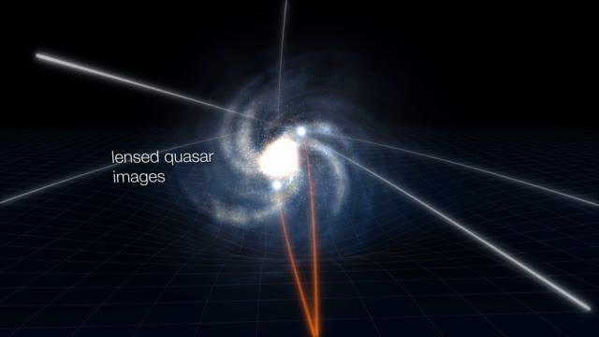
Investigation of physics and geometry in vicinity of SMBHs using gravitational microlensing
We developed a model of relativistic accretion disk around a SMBH based on ray-tracing method in Kerr metric and 3 models of gravitational microlenses

Slide 25
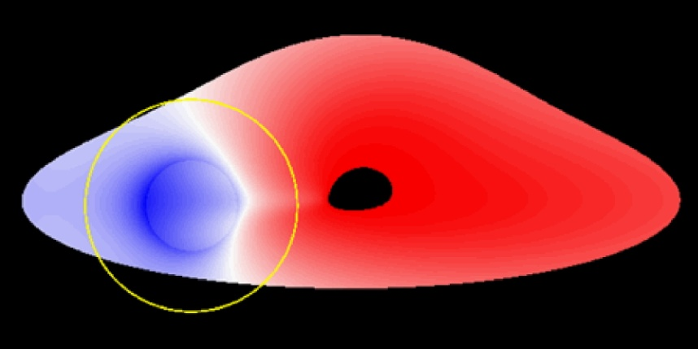
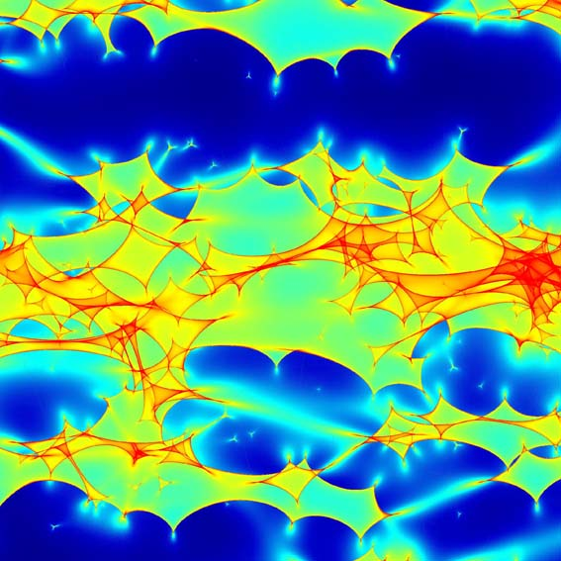
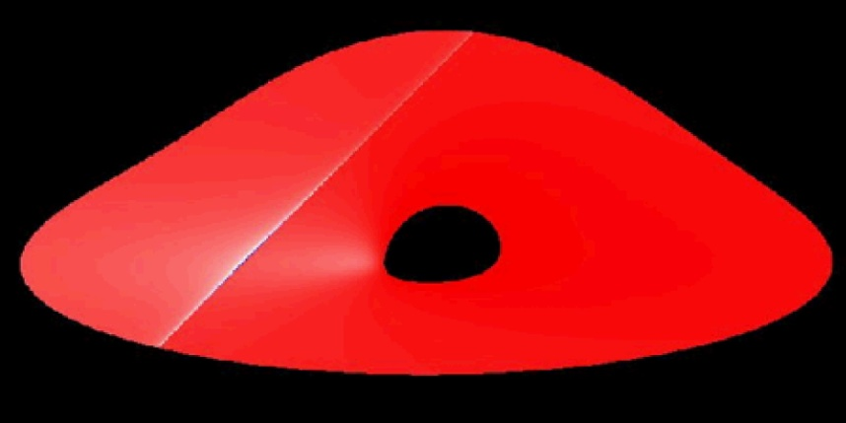
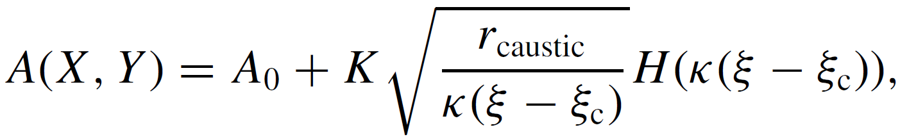
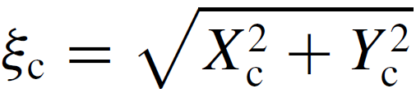
Simple models of gravitational microlenses
Point-like
Microlensing magnification map
Straight-fold caustic
Microlensing magnification map for image А of QSO 2237+0305 (k = 0.36, γ = 0.4)
Jovanović, 2006, Dissertatio Eddition, Andejević Foundation, Belgrade

Slide 26
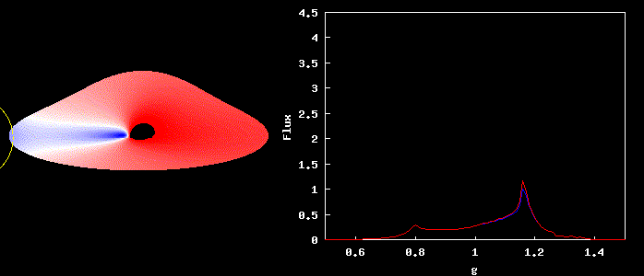
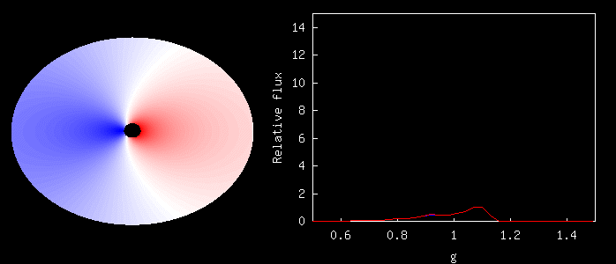
  Small mass microlenses can significantly affect the radiation emitted from the vicinity of the SMBHs

Slide 27

    Chromatic effects of gravitational microlensing
  Although microlensing is an achromatic effect, it can induce wavelength-dependent variations of the X-ray continuum of ~30%, due to the radial distribution of temperature in accretion disk
Popović, Jovanović, Mediavilla, Zakharov, Abajas, Muñoz, Chartas, 2006, ApJ, 637, 620

Slide 28




Microlensing timescales
Standard (but usually overestimated) timescale - time taken by a small source to cross the projected Einstein radius of a point-like lens:
"caustic time" - the time when the source is located in the area near the caustic:
In the case when source radius R_{source} is larger than the "caustic size" r_{caustic}, the relevant timescale is the "crossing time":
The effective source velocity v⊥ - the velocity of the source relative to the microlens with time measured by the observer:
v⊥
Jovanović et al. 2008, MNRAS, 386, 397

Slide 29



Magnification map of a "typical" lens system, where the white solid lines represent three analysed paths of an accretion disk.
Jovanović et al. 2008, MNRAS, 386, 397

Slide 30



  The variations of the X-ray radiations due to microlensing are the fastest and strongest when compared to the variations in optical, UV and IR range

Slide 31
Conclusions
Both strong and weak gravitational lenses represent the powerful tools in observational cosmology with wide range of applications:
  detection of dark matter and studying its distribution,
  constraining the cosmological parameters ,
  detection of the distant objects (natural telescopes),
  investigating the physics and geometry in the innermost regions of galaxies and quasars, close to their central SMBHs.
We studied gravitational lens statistics on a sample of lensed quasars in order to constrain the cosmological parameters and obtained the results which are in satisfactory agreement with other studies
We also investigated optical depth of cosmologically distributed gravitational microlenses and showed that it also depends on assumed cosmological model
We developed a model of relativistic accretion disk based on ray-tracing method in Kerr metric and 3 models of gravitational microlenses (point-like, caustic and magnification map), and used them to study the space-time geometry and accretion physics in vicinity of the SMBHs

Slide 32

Thank you for attention!

