Slide 1
“Classicalization” vs. Quantization of Tachyonic Dynamics
Goran S. Djordjević
In cooperation with D. Dimitrijević and M. Milošević
Department of Physics,
Faculty of Science and Mathematics
University of Niš
Serbia
8th MATHEMATICAL PHYSICS MEETING: Summer School and Conference on Modern Mathematical Physics
24 - 31 August 2014, Belgrade, Serbia

Slide 2
Outline
Tachyons, introduction and motivation
p-Adic inflation, strings and cosmology background
Tachyons – from field theory to the classical analogue – “classicalization”
DBI and canonical Lagrangians
Classical and Quantum dynamics in a zero-dimensional mode
Equivalency and canonical transformation
Instead of a Conclusion

Slide 3
Introduction
Quantum cosmology - to describe the evolution of the universe in a very early stage.
Related to the Planck scale - various geometries (nonarchimedean, noncommutative …).
“Dark energy” effect - expansion of the Universe is accelerating.
Different inflationary scenarios.
Despite some evident problems such as a non-sufficiently long period of inflation, tachyon-driven scenarios remain highly interesting for study.

Slide 4
p-Adic inflation from p-strings
p-Adic string theory was defined (Volovich, Freund, Olson (1987); Witten at al (1987,1988)) replacing integrals over R (in the expressions for various amplitudes in ordinary bosonic open string theory) by integrals over , with appropriate measure, and standard norms by the p-adic one.
This leads to an exact action in d dimensions, , .

Slide 5
p-Adic inflation (from strings)
The dimensionless scalar field describes the open string tachyon.
is the string mass scale and
is the open string coupling constant
Note, that the theory has sense for any integer and make sense in the limit

Slide 6
p-Adic inflation
Potential:
Rolling tachyons

Slide 7
Tachyons
String theory
A. Sen’s effective theory for tachyonic field:
- tachyon field
- potential
Non-standard type Lagrangian

Slide 8
In general
DBI Lagrangian:
Equation of motion (EoM):
EoM for spatially homogenous field:

Slide 9
In general
Lagrangian for spatially homogenous field:
Conjugated momentum:
Conserved Hamiltonian:

Slide 10
Relation with cosmology
Lagrangian (again):
Cosmological fluid described by the tachyonic scalar field:
Energy density and pressure:

Slide 11
Canonical transformation
How to quantize the system – Archimedean vs non-Archimedean case!?
Classical canonical transformation
Form of the generating function:
- new field, - old momentum

Slide 12
Canonical transformation
Connections:
Jacobian:
Poisson brackets:

Slide 13
Canonical transformation
Hamiltons’ equations:
EoM:

Slide 14
(smart) Choice for
If is integrable:
lower limit of the integral is chosen arbitrary
Second term in the EoM vanishes:

Slide 15
(smart) Choice for
EoM:
Two mostly used potentials:

Slide 16
Example 1
Exponential potential:
Function becomes
Leads to
Full generating function:
EoM:
Classically equivalent (canonical) Lagrangian:

Slide 17
Example 2
“One over cosh” potential:
Leads to
Full generating function:
EoM:
Classically equivalent (canonical) Lagrangian:

Slide 18
p-Adic case, numbers…
p – prime number
- field of p-adic numbers
Ostrowski: Only two nonequivalent norms over and
Reach mathematical analysis over

Slide 19
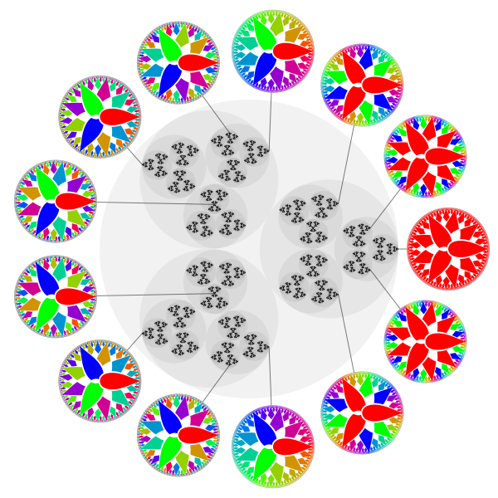
``Non-Archimedean`` – p-adic spaces
Compact group of 3-adic integers Z3 (black dotes)
The chosen elements are mapped (R)
Notes:
The compact group of 3-adic integers (black points), with selected elements labeled by the corresponding character on the Pontryagin dual group (the discrete Prüfer 3-group) (colored discs).
Counter-clockwise from the right, the labeled elements are 0, 9, 3, 1, −1/8, −1/2, 1/4, −1/4, 1/2, 1/8, −1, −3, and −9.
Each colored disc is tied to a 3-adic integer, x\in\mathbb{Z}_3, and it represents the corresponding character on the Prüfer 3-group, \chi_x : \mathbb{Z}(3^\infty) \to \mathbb{R}/\mathbb{Z}, defined by \chi_x(q) = x q. The circle group \mathbb{R}/\mathbb{Z} used is a color wheel where 0 = red, 1/3 = green, and 2/3 = blue.
http://en.wikipedia.org/wiki/P-adic_number

Slide 20
p-Adic QM
Feynman’s p-adic kernel of the evolution operator operatora
Aditive character –
Rational part of p-adic number –
Semi-classical expression also hold in the p-adic case

Slide 21
p-Adic QM
Lagrangian:
Action:
- elapsed time
Initial and final configuration: ,

Slide 22
p-Adic QM
The propagator:
Group property (evolutionary chain rule or Chapman-Kolmogorov equation) holds in general:
(Reminder: the infinitesimal version of this expression is the celebrated Schrödinger equation).

Slide 23
p-Adic QM ground state
The necessary condition for the existence of a p-adic (adelic) quantum model is the existence of a p-adic quantum-mechanical ground (vacuum) state:
Characteristic function of p-adic integers:

Slide 24
p-Adic QM ground state
Basic properties of the propagator
Leads to

Slide 25
p-Adic QM ground state
Necessary conditions for the existence of ground states in the form of the characteristic Ω-function
Interpretation

Slide 26
Conclusion
Tachyonic fields can be quantized on Archimedean and non-Archimedean spaces.
Dynamics of the systems are described via path integral approach
Classical analogue of the tachyonic fields on homogenous spaces is inverted oscillator lake system(s), in case of exponential like potentials.
How to calculate the wave function of the Universe with ``quantum tachyon fluid`` … ?
``Baby`` Universe?

Slide 27
Acknowledgement
The financial support under the
ICTP & SEENET-MTP Network Project PRJ-09 “Cosmology and Strings” and
the Serbian Ministry for Education, Science and Technological Development projects No 176021, No 174020 and No 43011. are kindly acknowledged
A part of this work is supported by CERN TH under a short term grant for G.S.Dj.
.

Slide 28
Reference
G.S. Djordjevic and Lj. Nesic TACHYON-LIKE MECHANISM IN QUANTUM COSMOLOGY AND INFLATIO in Modern trends in Strings, Cosmology and Particles Monographs Series: Publications of the AOB, Belgrade (2010) 75-93
G.S. Djordjevic, d. Dimitrijevic and M. Milosevic ON TACHYON DYNAMICS
under consideration in RRP
D.D. Dimitrijevic, G.S. Djordjevic and Lj. Nesic QUANTUM COSMOLOGY AND TACHYONS Fortschritte der Physik, Spec. Vol. 56, No. 4-5 (2008) 412-417
G.S. Djordjevic}}, B. Dragovich and Lj.Nesic ADELIC PATH INTEGRALS FOR QUADRATIC ACTIONS Infinite Dimensional Analysis, Quantum Probability and Related Topics Vol. 6, No. 2 (2003) 179-195
G.S. Djordjevic, B. Dragovich, Lj.Nesic and I.V. Volovich p-ADIC AND ADELIC MINISUPERSPACE QUANTUM COSMOLOGY Int. J. Mod. Phys. A17 (2002) 1413-1433
G.S. Djordjevic}}, B. Dragovich and Lj. Nesic p-ADIC AND ADELIC FREE RELATIVISTIC PARTICLE Mod. Phys. Lett.} A14 (1999) 317-325

Slide 29
Reference
G. S. Djordjevic, Lj. Nesic and D Radovancevic A New Look at the Milne Universe and Its Ground State Wave Functions ROMANIAN JOURNAL OF PHYSICS, (2013), vol. 58 br. 5-6, str. 560-572
D. D. Dimitrijevic and M. Milosevic: In: AIP Conf. Proc. 1472, 41 (2012).
G.S. Djordjevic and B. Dragovich p-ADIC PATH INTEGRALS FOR QUADRATIC ACTIONS Mod. Phys. Lett. A12, No. 20 (1997) 1455-1463
G.S. Djordjevic, B. Dragovich and Lj. Nesic p-ADIC QUANTUM COSMOLOGY, Nucl. Phys. B Proc. Sup. 104}(2002) 197-200
G.S. Djordjevic and B. Dragovich p-ADIC AND ADELIC HARMONIC OSCILLATOR WITH TIME-DEPENDENT FREQUENCY Theor.Math.Phys. 124 (2000) 1059-1067
D. Dimitrijevic, G.S. Djordjevic and Lj. Nesic ON GREEN FUNCTION FOR THE FREE PARTICLE Filomat 21:2 (2007) 251-260

Slide 30
T H A N K Y O U!

